Slide 1

Build Intelligent Apps with Azure OpenAI
Azure Application Innovation

Slide 2
Intelligent Apps Stack
Application (Modern/Legacy)
Intelligent Layer (LLM, Langchain/SK)
Structured Data
Unstructured Data

Slide 3
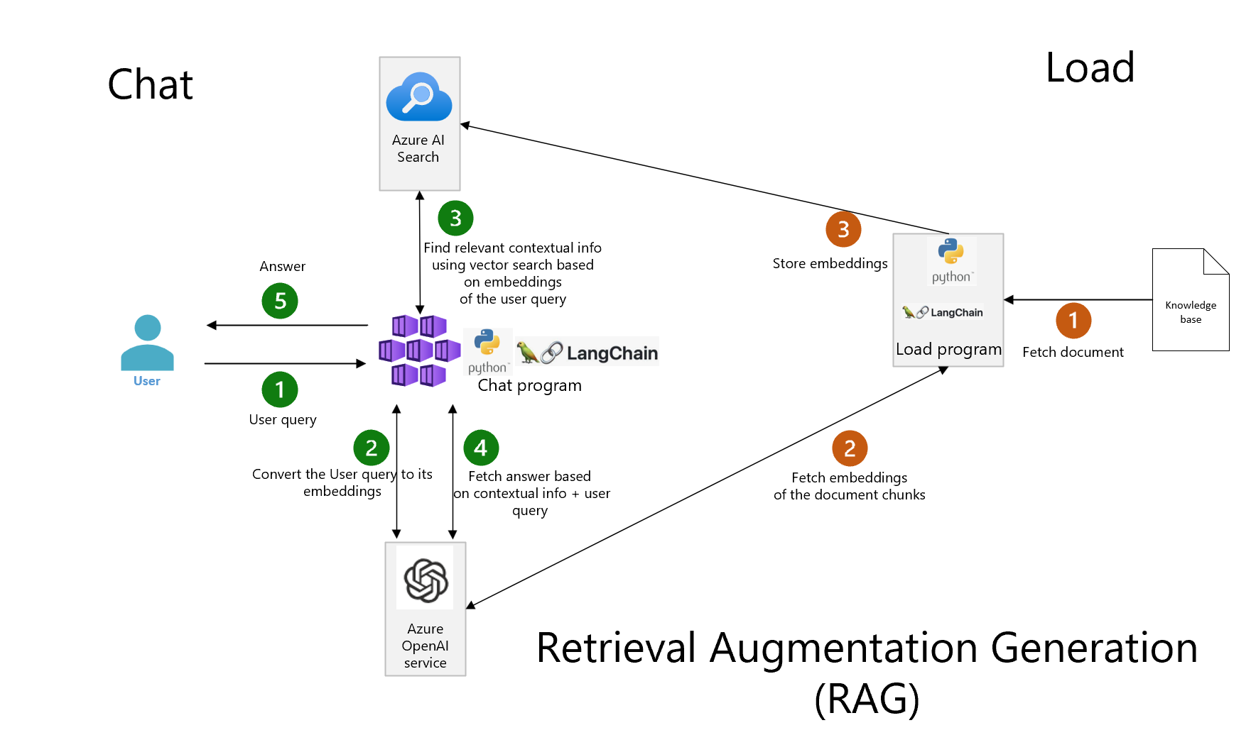
Unstructured Data Use Case (State Of The Union App)

Slide 4
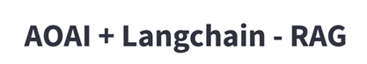

Slide 5
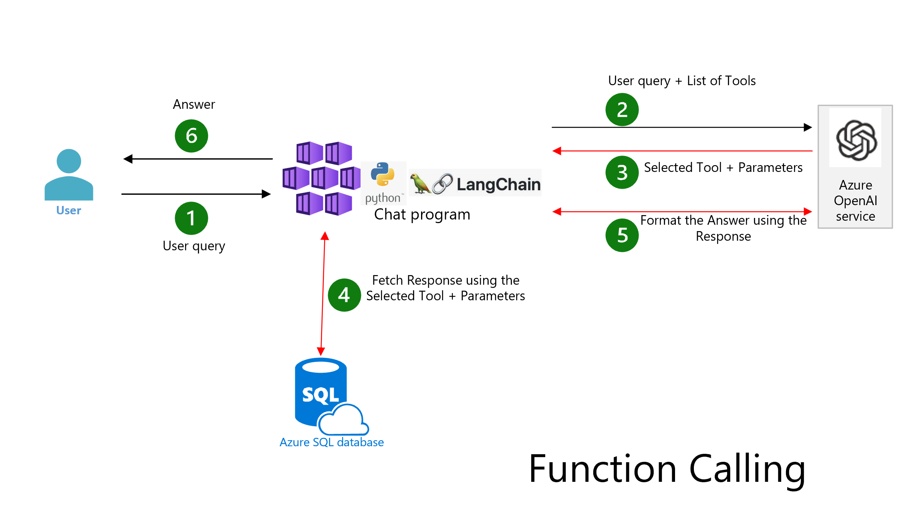
Structured Data Use Case – Travel App

Slide 12
AOAI+AKS

Slide 13
AOAI+APIM

